Slide 1

ANDROID PLATFORM

Slide 2
Agenda
What is Android?
Evolution of Android
Platform Architecture
Platform Initialization
Scope of Android
Advantages of Android

Slide 3
What is Android?
Android is a software platform and operating system for mobile devices, based on the Linux kernel.
A complete, end-to-end software platform that can be adapted to work on any number of hardware configurations.

Slide 4
Evolution of Android
Preliminary development by Google
Later taken up by the Open Handset Alliance (OHA)
Android is under version 2 of the Apache Software License (ASL).

Slide 5
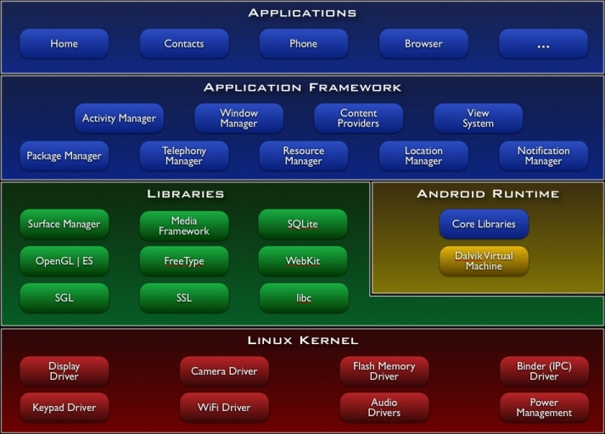

Slide 6
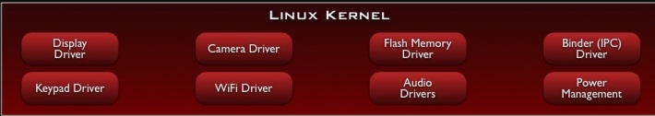
Linux Kernel
Android is built on the Linux kernel, but Android is not Linux.
Does not include the full set of standard Linux utilities
Standard Linux 2.6.24 Kernel

Slide 7
Why Linux Kernel?
Great memory and process management
Permissions-based security model
Proven driver model
Support for shared libraries
It’s already open source!

Slide 8
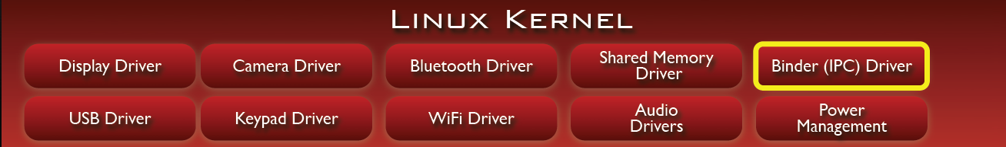
Binder: Problem
Applications and Services may run in separate processes but must communicate and share data
IPC can introduce significant processing overhead and security holes

Slide 9
Binder: Solution
Driver to facilitate inter-process communication (IPC)
High performance through shared memory
Reference counting, and mapping of object references across processes
Synchronous calls between processes

Slide 10
PM Problem
Mobile devices run on battery power
Batteries have limited capacity

Slide 11
PM Solution
Built on top of standard Linux Power Management (PM)
More aggressive power management policy
Components make requests to keep the power on through “wake locks”
Supports different types of wake locks

Slide 12
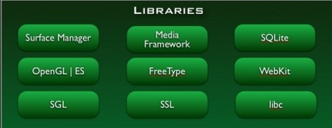
Libraries - Custom libc
optimized for embedded use.
Size: will load in each process, so it needs to be small
Fast: limited CPU power means we need to be fast

Slide 13
Libraries - Media Framework
Supports standard video, audio, still-frame formats
Support for hardware / software codec plug-ins

Slide 14
Surface Flinger
Surface
Apps
Frame
Buffer
Surface
Flinger
Surface
Apps
Surface

Slide 15
Android Run time - DVM
Provides application portability
Runs optimized file format (.dex) and Dalvik bytecode
Supports multiple virtual machine processes per device
Highly CPU-optimized bytecode interpreter
Uses runtime memory very efficiently

Slide 16
Appln Framework
Services that are essential to the Android platform
Eg. Activity Manager – manage appln lifecycle.
Package Manager holds information about applications loaded in the system

Slide 17
Runtime Walkthrough
It all starts with init…
Similar to most Linux-based systems at startup, the bootloader loads the Linux kernel and starts the init process.
Init
Linux Kernel

Slide 18
Runtime Walkthrough
Init process starts various daemons & the zygote.
The zygote is a nascent process which initializes a Dalvik VM instance.
Daemons
Zygote
Init

Slide 19
Runtime Walkthrough
runtime process Initializes Service Manager – the context manager for Binder
Runtime process sends request for Zygote to start System Service
Service Managers
Daemons
Run time
Zygote
Init

Slide 20
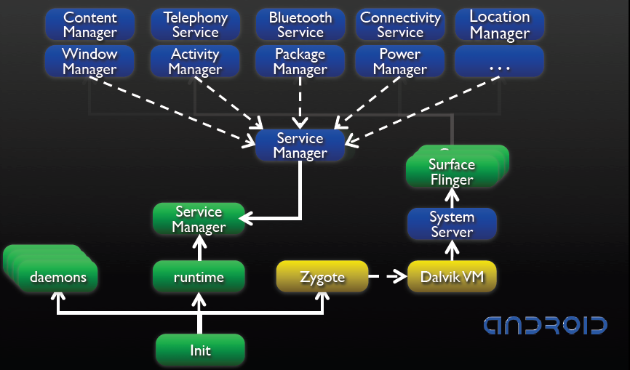

Slide 21
After system server loads all services, the system is ready

Slide 22
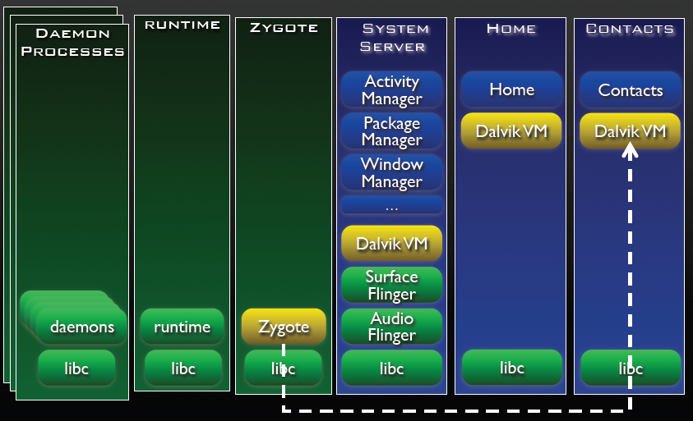
Each subsequent application is launched in itʼs own process

Slide 23
Scope of Android
Mobile users have far exceeded the no: of PC users.
Open source & hence free to develop & have lot of support on the web

Slide 24
Advantages of Android
The consumer will benefit from having a wide range of mobile applications to choose from.
The ability for anyone to customize the apps.
And lots more….

Slide 25
References
www.android.com
code.google.com
androidteam.googlecode.com

Slide 26
Q & A

